Slide 1
Introduction to
C++ Templates
C++ Function Templates
C++ Class Templates

Slide 2
Function templates - הגדרת פונקציה שתתאים ליותר מטיפוס אחד מבלי לשכתב את הקוד עבור כל טיפוס.
– Class templates הגדרת מחלקה שיכולים להיות לה שדות מטיפוסים שמתקבלים כפרמטרים למחלקה.
כשהקומפיילר מזהה שימוש ב Template מייצר אוטומטית פונקציה שמחליפה את הטיפוסים הטמפלטיים בטיפוסים האקטואליים.

Slide 3
C++ Function Templates
Approaches for functions that implement identical tasks for different data types
  Naive Approach
  Function Overloading
  Function Template
Instantiating a Function Templates

Slide 4
Approach 1: Naive Approach
create unique functions with unique names for each combination of data types
  difficult to keeping track of multiple function names
  lead to programming errors

Slide 5
Example
void PrintInt( int n )
{
cout << "***Debug" << endl;
cout << "Value is " << n << endl;
}
void PrintChar( char ch )
{
cout << "***Debug" << endl;
cout << "Value is " << ch << endl;
}
void PrintFloat( float x )
{
…
}
void PrintDouble( double d )
{
…
}
To output the values, we write:
PrintInt(sum);
PrintChar(initial);
PrintFloat(angle);

Slide 6
Approach 2:Function Overloading (Review)
  The use of the same name for different C++ functions, distinguished from each other by their parameter lists
  Eliminates need to come up with many different names for identical tasks.
  Reduces the chance of unexpected results caused by using the wrong function name.

Slide 7
Example of Function Overloading
void Print( int n )
{
cout << "***Debug" << endl;
cout << "Value is " << n << endl;
}
void Print( char ch )
{
cout << "***Debug" << endl;
cout << "Value is " << ch << endl;
}
void Print( float x )
{
}
To output the values, we write:
Print(someInt);
Print(someChar);
Print(someFloat);

Slide 8
Approach 3: Function Template
A C++ language construct that allows the compiler to generate multiple versions of a function by allowing parameterized data types.
FunctionTemplate
Template < TemplateParamList >
FunctionDefinition
TemplateParamDeclaration: placeholder
class typeIdentifier
typename variableIdentifier
Notes:
For most people, the first and most obvious use of templates is to define and use container classes such as string, vector, list and map. Soon after, the need for template functions arises. Sorting an array is a simple example:
template <class T> void sort(vector<T> &);
void f(vector<int>& vi, vector<string>& vs)
{
sort(vi);
sort(vs);
}
template<class T> void sort(vector<T> &v)
{
const size_t n = v.size();
for (int gap=n/2; 0 < gap; gap /= 2)
for (int I = gap; I < n; i++)
for (j = I – gap; 0 <= j; j-=gap)
if (v[j+gap]<v[j]) {
T temp = v[j];
v[j] = v[i];
v[j+gap] = temp;
}
}

Slide 9
Example of a Function Template
template<class T>
void Print( T val )
{
cout << "***Debug" << endl;
cout << "Value is " << val << endl;
T i;
i = i + val;
}
Template parameter
(class, user defined type, built-in types)
To output the values, we write:
Main()
{
Print(sum); //compilation error!!
Print<int>(sum);
Print<char>(initial);
Print<float>(angle);
Print<MyClass>( mc);
//operator << , = must be defined
}
Template argument

Slide 10
Instantiating a Function Template
When the compiler instantiates a template, it substitutes the template argument for the template parameter throughout the function template.
TemplateFunction Call
Function < TemplateArgList > (FunctionArgList)

Slide 11
Template function example (1)
#include <iostream>
using namespace std;
template <class T>
T max(T x, T y) //return type T
{
if (x>y)
return x;
return y;
}
void main()
{
cout<<max<int>(3,4)<<endl;
float a=5.25,b=3.5;
cout<<max<float>(a,b)<<endl;
cout<<max<char>('a','z')<<endl;
cout<<max<MyClass>('a','z')<<endl; // operator > and << must be defined for MyClass
}
Notes:
Shell sort

Slide 12
Template function example (2)
#include <iostream>
#include <stdlib.h> //for rand function
#include <time.h> //to start rand by timing
using namespace std;
template <class T>
void Swap(T & x & y)
{
T tmp = x; x = y; y = tmp;
}
template <class T>
void bubbleSort(T vec[], int size)
{
for (int last=size-1;last>0;last--)
for (int i = 0; i < last; i++)
if (vec[i+1] < vec[i])
Swap<T>(vec[i],vec[i+1]);
}
template <class T>
void print(T vec[], int size)
{
for(int i=0;i<size;i++)
cout<<vec[i]<<' ';
cout<<endl;
}
Notes:
Shell sort

Slide 13
Template function example (2) cont.
int main()
{
int integers[10];
srand((unsigned)time(NULL));
for (int i=0;i<10;i++)
integers[i] = rand() % 100;
bubbleSort<int>(integers,10);
print<int> (integers,10);
char characters[5];
for (int i=0;i<5;i++)
characters[i] = (rand() % 26)+65;
bubbleSort<char>(characters,5);
print<char>( (characters,5);
return 0;
}
Notes:
Shell sort

Slide 14
Summary of Three Approaches
Naive Approach
Different Function Definitions
Different Function Names
Function Overloading
Different Function Definitions
Same Function Name
Template Functions
One Function Definition (a function template)
Compiler Generates Individual Functions

Slide 15
Class Template
A C++ language construct that allows the compiler to generate multiple versions of a class by allowing parameterized data types.
Class Template
Template < TemplateParamList >
ClassDefinition
TemplateParamDeclaration: placeholder
class typeIdentifier
typename variableIdentifier

Slide 16
Example of a Class Template
template<class T>
class GList
{
public:
bool IsEmpty() const;
bool IsFull() const;
int Length() const;
void Insert(T item );
void Delete(T item );
bool IsPresent(T item ) const;
void SelSort();
void Print() const;
GList(); // Constructor
private:
int length;
T data[MAX_LENGTH];
};
Template parameter
Notes:
Template <class ItemType> says that ItemType is a type name, it need not be the name of a class.
The scope of ItemType extends to the end of the declaration prefixed by template <class ItemType>

Slide 17
Instantiating a Class Template
Class template arguments must be explicit.
The compiler generates distinct class types called template classes or generated classes.
When instantiating a template, a compiler substitutes the template argument for the template parameter throughout the class template.
Notes:
The process of generating a class declaration from a template class and a template argument is often called template instantiation. Similarly, a function is generated (“instantiated”) from a template function plus a template argument. A version of a template for a particular template argument is called a specialization.

Slide 18
Instantiating a Class Template
To create lists of different data types
// Client code
GList<int> list1;
GList<float> list2;
GList<string> list3;
list1.Insert(356);
list2.Insert(84.375);
list3.Insert("Muffler bolt");
template argument
Compiler generates 3 distinct class types
GList_int list1;
GList_float list2;
GList_string list3;
Notes:
The name of a class template followed by a type bracketed by <> is the name of a class (as defined by the template) and can be used exactly like other class names.

Slide 19
Substitution Example
class GList_int
{
public:
void Insert(int item );
void Delete(int item );
bool IsPresent(int item ) const;
private:
int length;
int data[MAX_LENGTH];
};
int
int
int
int

Slide 20
Function Definitions for Members of a Template Class
template<class T>
bool GList<T>:: IsFull() const {//…};
template<class T>
void GList<T>::Insert(T item )
{
data[length] = item;
length++;
}
//after substitution of float
void Glist_float::Insert(float item )
{
data[length] = item;
length++;
}

Slide 21
Another Template Class Example: passing two parameters
template <class T, int size>
class Stack {...
T buf[size];
};
Stack<int,128> mystack;
non-type parameter
Notes:
A template can take type parameters, parameters of ordinary types such as ints, and template parameters.
For example, simple and constrained containers such as Stack or Buffer can be important where run-time efficiency and compactness are paramount. Passing a size as a template argument allows Stack’s implementer to avoid free store use.
An integer template argument must be constant

Slide 22
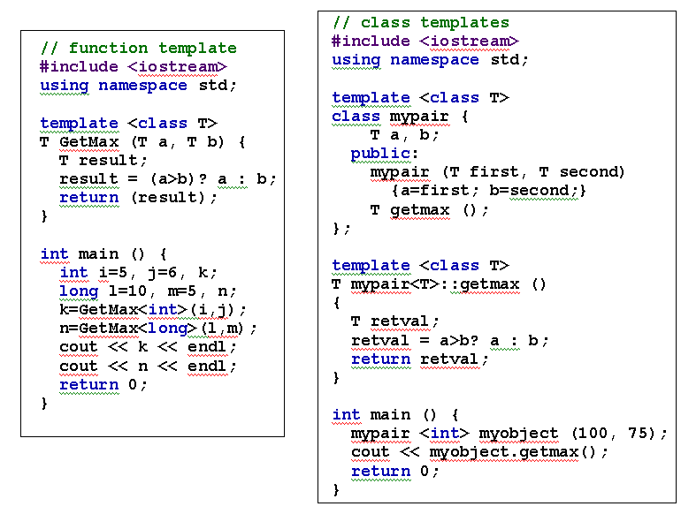
Another Template Examples
Notes:
A template can take type parameters, parameters of ordinary types such as ints, and template parameters.
For example, simple and constrained containers such as Stack or Buffer can be important where run-time efficiency and compactness are paramount. Passing a size as a template argument allows Stack’s implementer to avoid free store use.
An integer template argument must be constant

Slide 23
Standard Template Library
In the late 70s Alexander Stepanov first observed that some algorithms do not depend on some particular implementation of a data structure but only on a few fundamental semantic properties of the structure
Developed by Stepanov and Lee at HP labs in 1992
Become part of the C++ Standard in 1994
Notes:
STL, is a C++ library of container classes, algorithms, and iterators; it provides many of the basic algorithms and data structures of computer science. The STL is a generic library, meaning that its components are heavily parameterized: almost every component in the STL is a template.

Slide 24
What’s in STL?
Container classes: vector, list, deque, set, map, and etc…
A large collection of algorithms, such as reverse, swap, heap, and etc.
Notes:
Like many class libraries, the STL includes container classes: classes whose purpose is to contain other objects. The STL includes the classes vector, list, deque, set, multiset, map, multimap, hash_set, hash_multiset, hash_map, and hash_multimap.
A list is a doubly linked list. That is, it is a Sequence that supports both forward and backward traversal, and (amortized) constant time insertion and removal of elements at the beginning or the end.
A deque is very much like a vector: like vector, it is a sequence that supports random access to elements, constant time insertion and removal of elements at the end of the sequence, and linear time insertion and removal of elements in the middle
Set is a container that stores objects in a sorted manner.
Map is also a set, the only difference is that in a map, each element must be assigned a key.

Slide 25
Vector
A sequence that supports random access to elements
  Elements can be inserted and removed at the beginning, the end and the middle
  Constant time random access
  Commonly used operations
    begin(), end(), size(), [], push_back(…), pop_back(), insert(…), empty()

Slide 26
Example of vectors
// Instantiate a vector
vector<int> V;
// Insert elements
V.push_back(2); // v[0] == 2
V.insert(V.begin(), 3); // V[0] == 3, V[1] == 2
// Random access
V[0] = 5; // V[0] == 5
// Test the size
int size = V.size(); // size == 2

Slide 27
Take Home Message
Templates are mechanisms for generating functions and classes on type parameters. We can design a single class or function that operates on data of many types
    function templates
    class templates

